Slide 1
Mobile Network Layer

Slide 2
Mobile network layer
Idea is that the network layer to support mobility.
Example is Mobile IP, which adds mobility support to the internet network layer protocol IP.
Today’s internet lacks any mechanisms to support users traveling around the world.
IP is the common base for thousands of applications and runs over dozens of different networks.
This is the reason for supporting mobility at the IP layer.

Slide 3
Mobile network layer
To merge the world of mobile phones with the internet and to support mobility in the small more efficiently,
micro mobility protocols have been developed.
Another kind of mobility, portability of equipment, is supported by the dynamic host configuration protocol (DHCP).
Today, due to laptops or notebooks, students show up at a university with their computers, and want to plug them in or use wireless access.
A network administrator does not want to configure dozens of computers every day or hand out lists of valid IP addresses, DNS servers, subnet prefixes, default routers etc.
DHCP sets in at this point to support automatic configuration of computers.

Slide 4
Mobile IP
The internet is the network for global data communication with hundreds of millions of users. So why not simply use a mobile computer in the internet?

Slide 5
Mobile IP
You will not receive a single packet as soon as you leave your home network, i.e., the network your computer is configured for, and reconnect your computer (wireless or wired) at another place.

Slide 6
Mobile IP
if you consider routing mechanisms on the internet.
A host sends an IP packet with the header containing a destination address. The destination address not only determines the receiver of the packet, but also the physical subnet of the receiver.
For example, the destination address 129.13.42.99 shows that the receiver must be connected to the physical subnet with the network prefix 129.13.42.
Incoming packets are forwarded by routers according to internal look-up tables storing only prefixes.
As soon as it moves outside the subnet, a packet will not reach it.
A host needs a so-called topologically correct address.

Slide 7
Mobile IP
Quick solutions
A quick solution to this problem would be to assign to the computer a new, topologically correct IP address.
This is what many users do with the help of DHCP.
The problem is that almost impossible to find a (mobile) host on the internet which has just changed its address.

Slide 8
Mobile IP
Quick solutions
One could argue that with the help of dynamic DNS an update of the mapping logical name – IP address is possible.
Computer users with a dynamic IP addresses but with same logical name still want to be permanently reachable.
These considerations, are important if a user wants to offer services from a mobile node.
The IP address is of no special interest for service usage: DHCP is
sufficient.
Another motivation for permanent IP addresses is emergency communication with permanent and quick reachability via the same IP address.

Slide 9
Mobile IP
Quick solutions
So dynamically adapting the IP address with regard to the current location?
The problem is that the DNS needs some time to map a logical name to an IP.
This approach does not work if the mobile node moves quite often.
Imagine millions of nodes moving at the same time.
There is a severe problem with higher layer protocols like TCP which rely on IP addresses.
Changing the IP address while still having a TCP connection open means breaking the connection.
A TCP connection is identified by the tuple (source IP, source port, destination IP, destination port).

Slide 10
Mobile IP
Quick solutions
Another approach is the creation of specific routes to the mobile node
While it is theoretically possible to change routing tables all over the world to create specific routes to a mobile node
This does not scale at all in the internet.
Allow changes to the routing tables, sacrificing stability, just to provide mobility for individual users.

Slide 11
Mobile IP
Several requirements accompanied the development of the Mobile IP standard:
Compatibility
Transparency
Scalability and efficiency
Security

Slide 12
Compatibility
A new standard cannot introduce changes for TCP/IP protocols (applications or network protocols already in use).
People still want to use their favorite browser and OS.
Routers should not necessarily require other software.
Possible to enhance the capabilities of some routers to support mobility.
remain compatible with all lower layers used for the standard, non-mobile IP.
Mobile IP must not require special media or MAC/LLC protocols, use same interfaces.
Finally, end-systems enhanced with a mobile IP implementation should still work with fixed systems without mobile IP.
Same address format and routing mechanisms should be used.

Slide 13
Transparency
Mobility should remain ‘invisible’ for many higher layer protocols and applications.
Besides maybe noticing a lower bandwidth and some interruption in service
higher layers should continue to work even if the mobile node has changed its point of attachment.
If the interruption of the connectivity does not take too long, TCP connections survive the change of the attachment point.
Applications have not been designed for use in mobile environments.
Some applications for which it is better to be ‘mobility aware’
Additional mechanisms are necessary to inform these applications about mobility

Slide 14
Scalability and efficiency
A new mechanism must not jeopardize its efficiency.
Enhancing IP for mobility must not generate too many new messages
flooding the whole network.
Many mobile systems will have a wireless link to an attachment point,
Some additional packets should be necessary between a mobile system and a node
It is clear that myriad devices (car, mobile phones etc.) will participate in the internet as mobile components
Many of them will have some IP implementation inside and move between different networks and require mobile IP
It is crucial for a mobile IP to be scalable over a large number of participants in the whole internet, worldwide.

Slide 15
Security
Mobility poses many security problems.
The minimum requirement is that of all the messages related to the management of Mobile IP are authenticated.
The IP layer must be sure that if it forwards a packet to a mobile host that this host receives the packet.
The IP layer can only guarantee that the IP address of the receiver is correct.
There are no ways of preventing fake IP addresses or other attacks.
According to Internet philosophy, this is left to higher layers

Slide 16
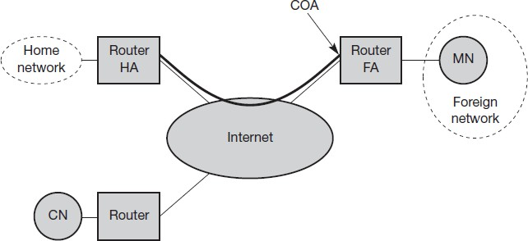
Mobile IP example network

Slide 17
Mobile IP Entities
Mobile node (MN)
A mobile node is an end-system or router that can change its point of attachment to the internet using mobile IP.
The MN keeps its IP address and can continuously communicate with any other system in the internet as long as link-layer connectivity is given.
Mobile nodes are not necessarily small devices such as laptops with antennas or mobile phones

Slide 18
Mobile IP Entities
Correspondent node (CN)
At least one partner is needed for communication.
The CN can be a fixed or mobile node.
Home network
The home network is the subnet the MN belongs to with respect to its IP address.
No mobile IP support is needed within the home network.

Slide 19
Mobile IP Entities
Foreign network
The foreign network is the current subnet the MN visits and which is not the home network.
Foreign agent (FA)
It can provide several services to the MN during its visit to the foreign network.
The FA can have the COA, acting as tunnel endpoint and
forwarding packets to the MN.
The FA can be the default router for the MN.
FAs can also provide security services
For mobile IP functioning, FAs are not necessarily needed. Typically, an FA is implemented on a router for the subnet the MN attaches to.

Slide 20
Mobile IP Entities
Care-of address (COA)
The COA defines the current location of the MN
All IP packets sent to the MN are delivered to the COA, not directly to the IP address of the MN. Packet delivery toward the MN is done using a tunnel.
There are two different possibilities for the location of the COA:
Foreign agent COA: The COA could be located at the FA, i.e., the COA is an IP address of the FA. Many MN using the FA can share this COA as common COA.
Co-located COA:
The COA is co-located if the MN temporarily acquired an additional IP address which acts as COA.
This address is topologically correct, acquired using DHCP and the tunnel endpoint is at the MN.
One problem associated with this approach is the need for additional addresses

Slide 21
Mobile IP Entities
Home agent (HA)
The HA provides several services for the MN and is located in the home network.
The tunnel for packets toward the MN starts at the HA.
The HA maintains a location registry, i.e., it is informed of the MN’s
location by the current COA.

Slide 22
Mobile IP Entities
Three alternatives for the implementation of an HA exist.
The HA can be implemented on a router of the home network.
This is obviously the best position, because without optimizations to mobile IP, all packets for the MN have to go through the router anyway.
If changing the router’s software is not possible, the HA could also be implemented on an arbitrary node in the subnet.
One disadvantage of this solution is the double crossing of the router by the packet if the MN is in a foreign network. The HA sends it through the tunnel which again crosses the router.
Finally, a home network is not necessary at all. The HA could be again on the ‘router’ but this time only acting as a manager for MNs belonging to a virtual home network.
All MNs are always in a foreign network with this solution.

Slide 23
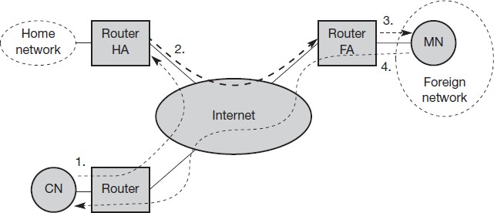
IP packet delivery
A correspondent node CN wants to send an IP packet to the MN. CN does not need to
know
MN’s
anything about the current location and
sends the packet as usual to the IP address of MN (step 1).
The internet routes the packet to the router responsible for the home network of MN.
This is the standard routing mechanisms of the internet.

Slide 24
IP packet delivery
The HA
now intercepts the
is
packet, currently network.
knowing that MN
not in its home
The packet is not forwarded into the subnet as usual, but encapsulated and tunneled to the COA.
A new header is put in front of the old IP header showing the COA as new destination and HA as source of the encapsulated packet (step 2).

Slide 25
IP packet delivery
The foreign agent now de-capsulates the packet, i.e., removes the additional header, and forwards the original packet with CN as source and MN as destination to the MN (step 3).
Again, for the MN mobility is not visible.

Slide 26
IP packet delivery
The MN sends the packet as usual
with its
own fixed IP source and CN’s
address as address as
destination (step 4).
The router forwards the packet in the same way as it would do for any other node in the foreign network.
If CN is a fixed node it happens as in the fixed internet.
If CN is a mobile node residing in a foreign network, mechanism follows the steps 1 through 3.

Slide 27
Agent discovery
How to find a foreign agent? How does the MN discover that it has
moved?
Agent advertisement
FAs and HAs advertise their presence periodically using special agent advertisement messages.
These advertisement messages as a beacon broadcast into the subnet.
For these advertisements, Internet control message protocol (ICMP) messages are used with some mobility extensions.
Routers in the fixed network implementing this standard also advertise their routing service periodically to the attached links.

Slide 28
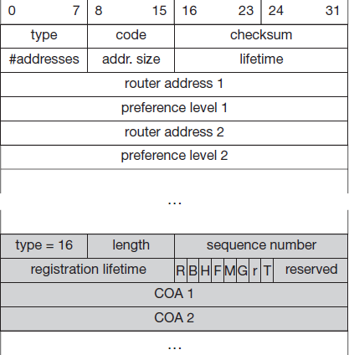
Agent advertisement
The upper part represents the ICMP packet while the lower part is the extension needed for mobility.
The TTL field of the IP packet is set to 1 for all advertisements to avoid forwarding them.
The IP destination address according to standard router advertisements can be either set to 224.0.0.1, which is the multicast address for all
systems on a link broadcast 255.255.255.255.
or to the
address
Figure: Agent Advertisement Packet

Slide 29
Agent advertisement
The type is set to 9, the code can be 0, if the agent also routes traffic from non-mobile nodes, or 16, if it does not route anything other than mobile traffic.
Foreign agents are at least required to forward packets from the mobile node.
The number of addresses advertised with this packet is in
#addresses while the addresses themselves follow as shown.
Lifetime denotes the length of time this advertisement is valid.
Preference levels for each address help a node to choose the router that is the most eager one to get a new node.

Slide 30
Agent advertisement
type is set to 16, length depends on the number of COAs provided with the message and equals 6 + 4*(number of addresses).
An agent shows the total number of advertisements sent since initialization in the sequence number.
By the registration lifetime the agent can specify the maximum lifetime in seconds a node can request during registration.

Slide 31
The following bits specify the characteristics of an agent in detail
The R bit (registration) shows, if a registration with this agent is required even when using a co-located COA at the MN.
If the agent is currently too busy to accept new registrations it can set the B bit.
if the agent offers services as a home agent (H) or foreign agent
(F) on the link where the advertisement has been sent.
Bits M and G specify the method of encapsulation used for the tunnel.
While IP-in-IP encapsulation is the mandatory standard, M can specify minimal encapsulation and G generic routing encapsulation.

Slide 32
The following bits specify the characteristics of an agent in detail
In first version of mobile IP the V bit specified the use of header compression.
Now the field r at the same bit position is set to zero and must be ignored.
The new field T indicates that reverse tunneling is supported by the FA.
A foreign agent setting the F bit must advertise at least one COA.
A mobile node in a subnet can now receive agent advertisements from either its home agent or a foreign agent.
This is one way for the MN to discover its location.

Slide 33
Agent solicitation
If no agent advertisements are present or the inter-arrival time is too high, and an MN has not received a COA by other means, e.g., DHCP
The mobile node must send agent solicitations.
Ensure that these solicitation messages do not flood the network, but basically an MN can search for an FA endlessly sending out solicitation messages
Typically, a mobile node can send out three solicitations, one per second
Moving MNs with applications requiring continuous packet streams even one second intervals between solicitation messages might be too long.
Before an MN even gets a new address many packets will be lost without additional mechanisms.

Slide 34
Agent solicitation
In case of no answer to its solicitations
It must decrease the rate of solicitations exponentially to avoid flooding the network until it reaches a maximum interval between solicitations (typically one minute).
Discovering a new agent can be done anytime, not just if the MN is not connected to one.
Consider the case that an MN is looking for a better connection while still sending via the old path.
This is the case while moving through several cells of different wireless networks.

Slide 35
Agent solicitation
After these steps of advertisements or solicitations
The MN can now receive a COA, either one for an FA or a co- located COA.
The MN knows its location (home network or foreign network) and the capabilities of the agent (if needed).
The next step for the MN is the registration with the HA if the MN is in a foreign network as described in the following.

Slide 36
Registration
The main purpose of the registration is to inform the HA of the current location for correct forwarding of packets.

Slide 37
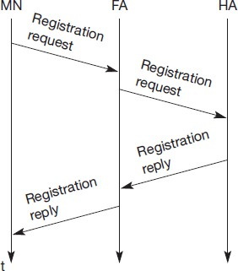
Registration
Registration can be done in two ways:
If the COA is at the FA
The MN sends its registration request containing the COA to the FA which is forwarding the request to the HA.
The HA now sets up a mobility binding containing the mobile node’s home IP address and the current COA.

Slide 38
Registration
Additionally,
the mobility binding
contains the lifetime of the registration which is negotiated during the registration process.
Registration expires automatically after the lifetime and is deleted.
After setting up the mobility binding, the HA sends a reply message back to the FA which forwards it to the MN.

Slide 39
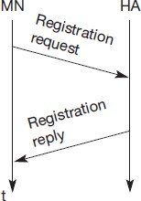
Registration
If the COA is co-located
Registration can be simpler
The MN may send the request directly to the HA and vice versa
This, by
the
way, is also the
MNs
registration
procedure for
returning to their home network
However, if the MN received an
agent advertisement from the FA
it should register via this FA if the
R bit is set in the advertisement.

Slide 40
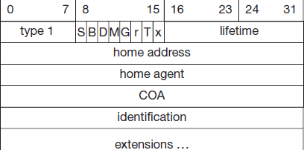
UDP packets are used for
registration requests.
The IP source address of the packet is set to the interface address of the MN,
The IP destination address is that of the FA or HA (depending on the location of the COA).
The UDP destination port is set to 434.
Figure: Registration request
UDP is used because of low overheads and better performance compared to TCP in wireless environments.
The fields relevant for mobile IP registration requests follow as UDP data.

Slide 41
The type = 1 for a registration request.
With the S bit an MN can specify if it wants the HA to retain prior mobility bindings.
This allows for simultaneous bindings.
B bit indicates that an MN also wants to receive the broadcast packets which have been received by the HA in the home network.
Figure: Registration request
If an MN uses a co-located COA, it also takes care of the de-capsulation at the tunnel endpoint. The D bit indicates this behavior.

Slide 42
M and G denote the use of minimal encapsulation or generic routing encapsulation, respectively.
T indicates reverse tunneling, r and x
are set to zero.
Figure: Registration request

Slide 43
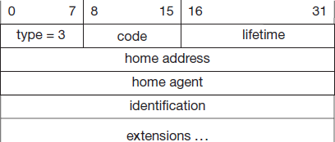
Lifetime denotes the validity of the registration in seconds.
A value of zero indicates deregistration; all bits set indicates infinity.
The home address is the fixed IP address of the MN
home agent is the IP address of the HA, and COA represents the tunnel endpoint.
Figure: Registration reply

Slide 44
The 64 bit identification is generated by the MN to identify a request and match it with registration replies.
This field is used for protection against replay attacks of registrations.
The extensions must at least
for
contain parameters
authentication.
Registration reply

Slide 45
A registration reply, which is conveyed in a UDP packet, contains a type field set to 3 and a code indicating the result of the registration request.

Slide 46
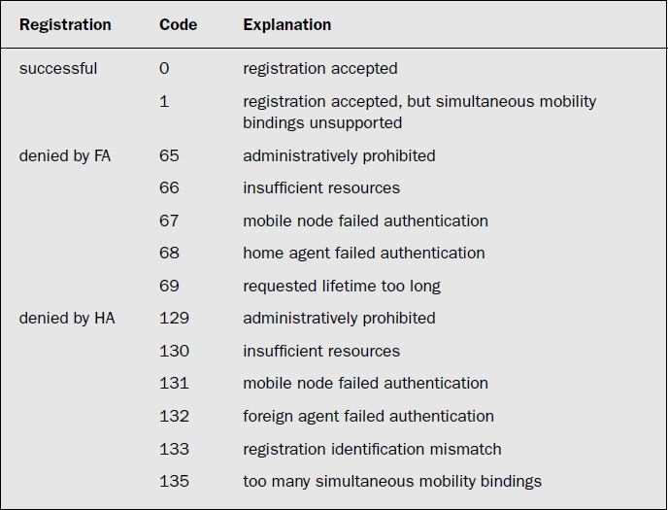

Slide 47
The lifetime field indicates how many seconds the registration is valid if it was successful.
Home address and home agent are the addresses of the MN and the HA, respectively.
The 64-bit identification is used to match registration requests with replies. The value is based on the identification field from the registration and the authentication method.
Again, the extensions must at least contain parameters for authentication.

